Slide 1

Ansible
Mustafa Noori and Namratha Balbadri
ESDE – Fontys University of Applied Sciences

Slide 2
AGENDA
What is Ansible?
Why Ansible?
How Ansible works?
When is Ansible used?
Important Terminologies
Real Life Use Case
Ansible vs alternatives Tools
Next ?

Slide 3

What is Ansible?
Ansible is an IT automation tool. It can configure systems, deploy software, and orchestrate more advanced IT tasks such as continuous deployments or zero downtime rolling updates.

Slide 4
Why Ansible?
To perform repetitive tasks:
Update
Back Ups
System Reboots
Create User
Assign Groups
Assign Permissions

Slide 5



Why Ansible?
Less Time Consuming
More Efficient
Less Likely for Errors

Slide 6
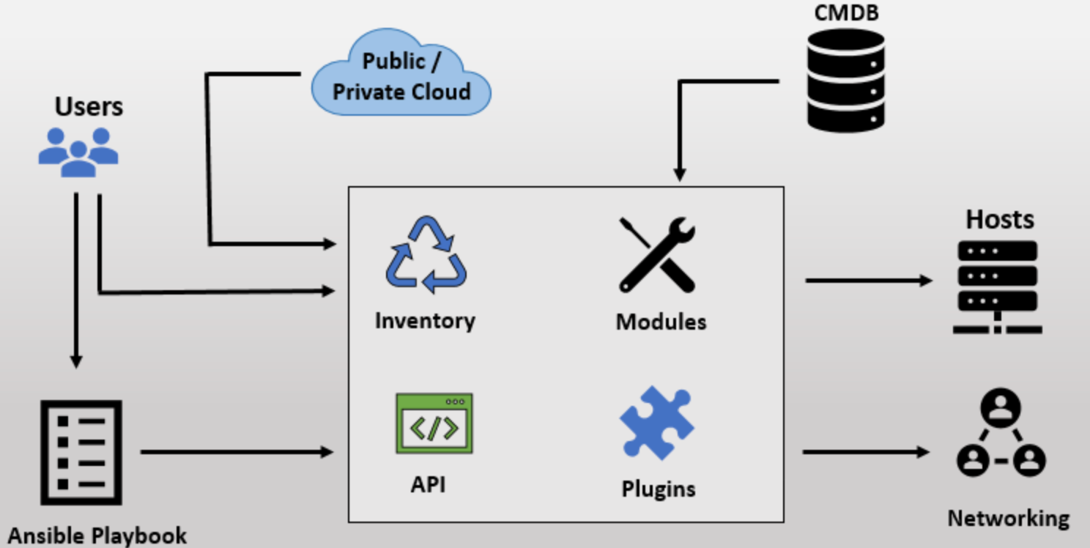
How Ansible work?
Modules
Module = one small specific task.
Get pushed to the target server.
Do their work and get removed.
Ansible uses YAML.

Slide 7
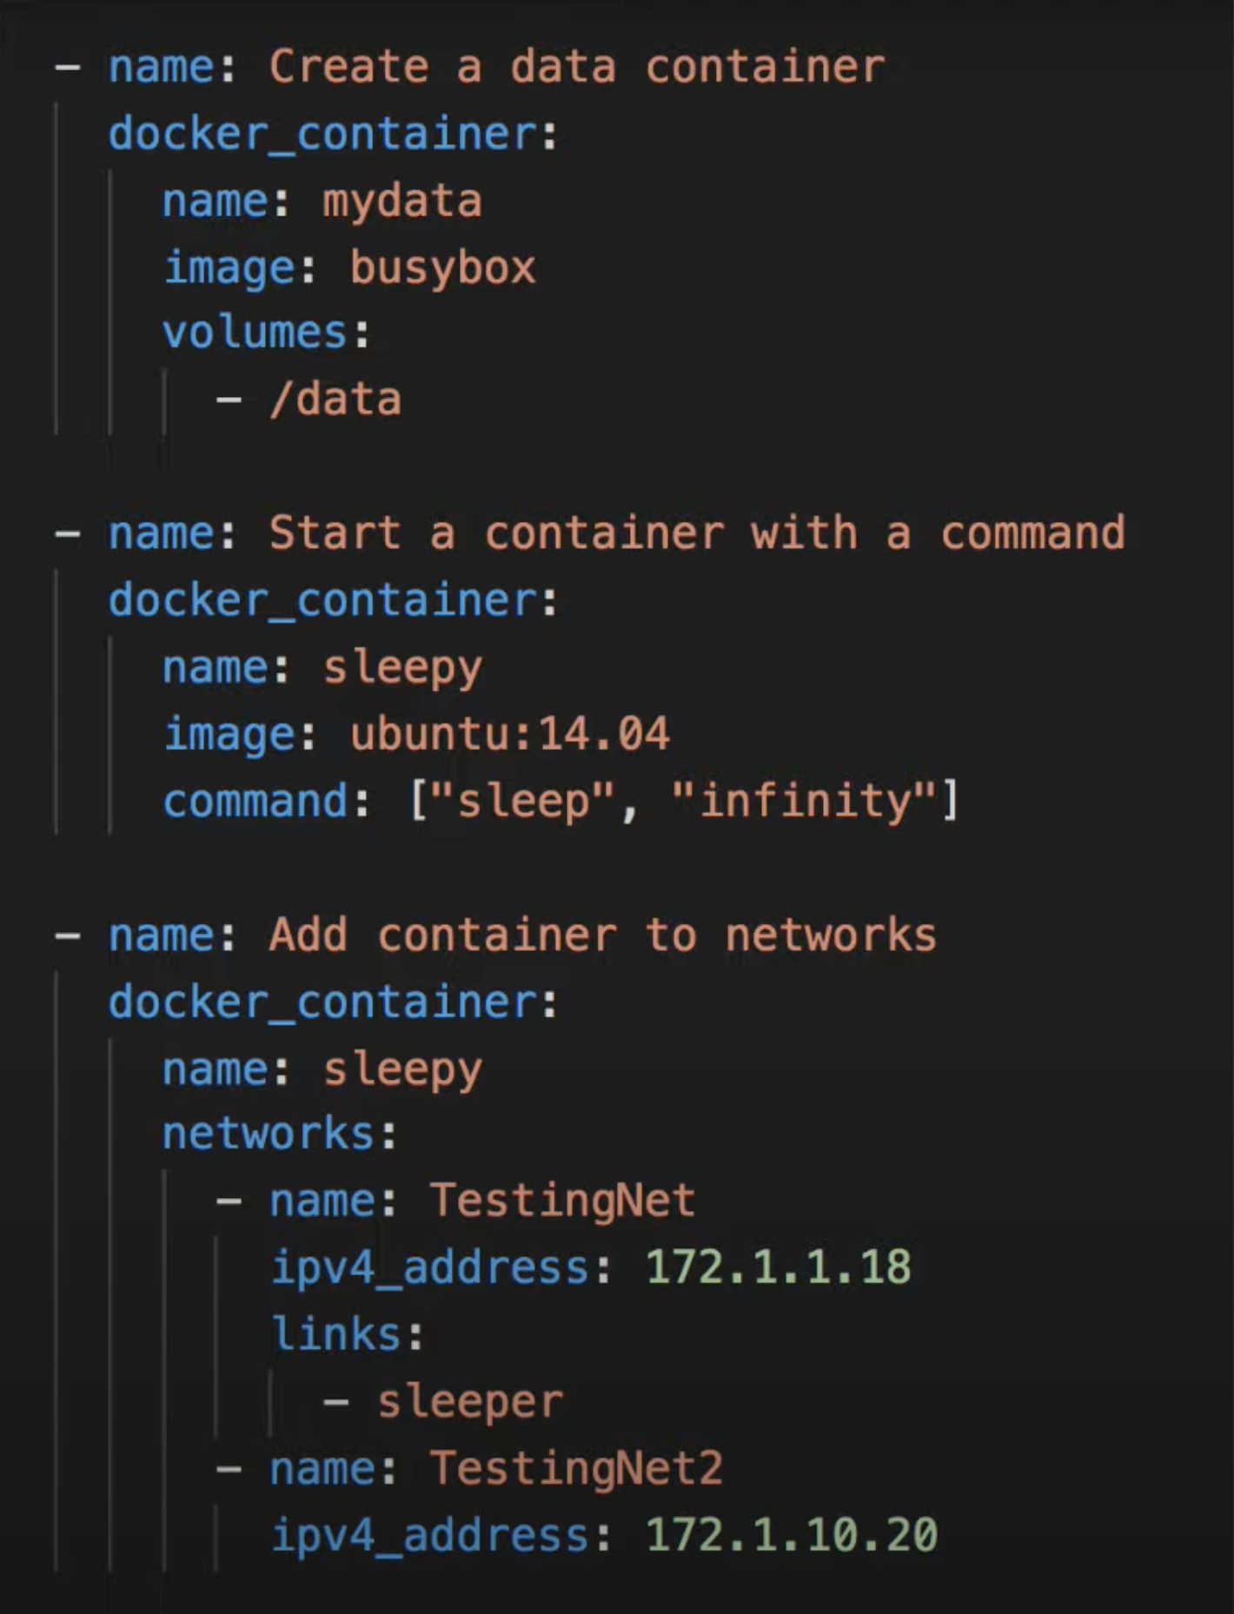
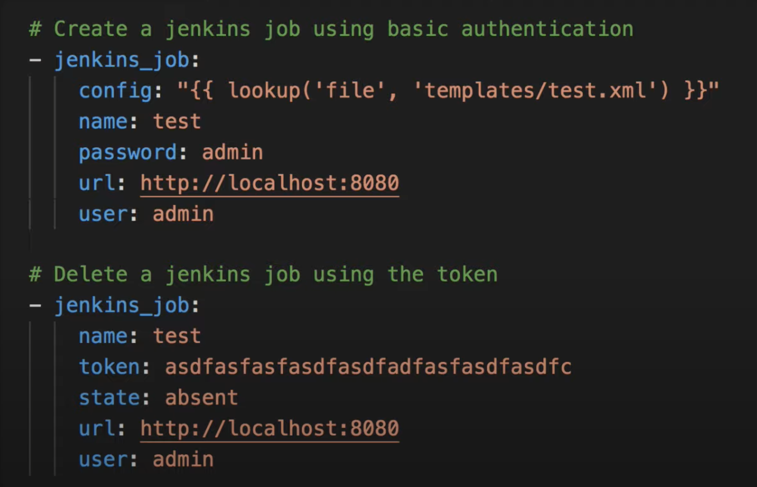
Example module usages
Jenkins Module
Creating a job deleting a job
Docker Module
Create container.
Start container
Apply config

Slide 8
When is Ansible used?
Its an agentless tool once installed on a machine, it can manage other servers remotely. So you don’t need any deployment effort in beginning and no effort for upgrade.

Slide 9






Supporting all infrastructure
From operating systems..
Application deployment
Creating and managing DBs
Cloud provisioning
OS level updates
..to cloud Provider

Slide 10
Important Ansible Key Terms
Playbooks
Server
Target Machine
Task
Machine
Modules
Roles
Variables

Slide 11
Ansible vs alternative Tools
Ansible
Puppet and Chef
Ruby more difficult to learn
Installation needed
So need for managing updates on target servers.
Free
Simple YAML
Agentless
Powerful
Efficient

Slide 12
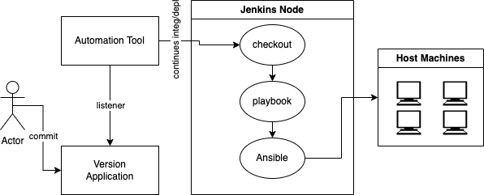
Real Life Use Case

Slide 13
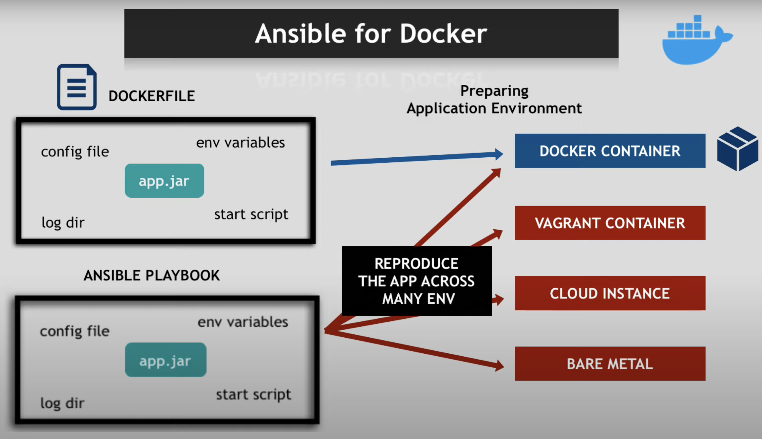
Ansible usage.

Slide 14
Next ?
Quiz: https://quizizz.com/join

Slide 15
Source
https://docs.ansible.com/ansible-core/devel/index.html
https://www.logicmonitor.com/blog/ansible-key-terms-getting-started
https://www.youtube.com/watch?v=1id6ERvfozo&t=831s&ab_channel=TechWorldwithNana
https://www.simplilearn.com/tutorials/ansible-tutorial/what-is-ansible#benefits_of_ansible

